Slide 1
Invisible Disabilities
Meeting Individual Student Needs during Fine and Performing Arts
Presented by:
Dr. Keingstein

Slide 2
Common Invisible Disabilities in Schools
An invisible disability is anything that cannot be seen. It can be…
Anxiety Disorder (many types)
Depression
Obsessive-compulsive disorder
Oppositional Defiant Disorder
ADHD
Autism
Learning Disorders
Etc.
https://youtu.be/QkiW1tPP02s

Slide 3
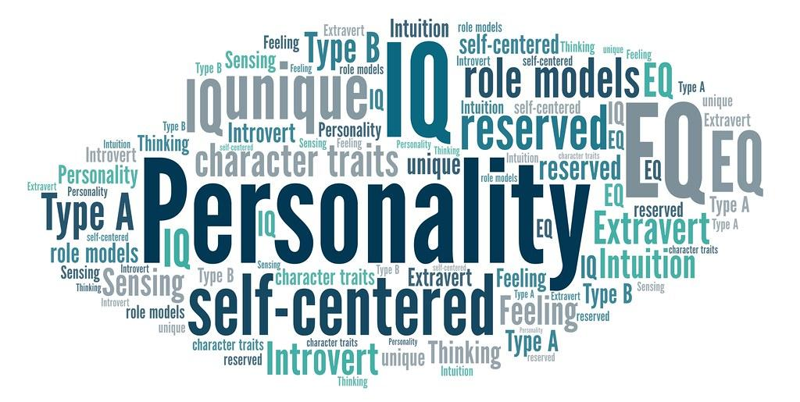
What is an invisible disability?
Invisible disabilities may affect the way a student processes, retains, and communicates information.
Some Common Characteristics:
A student may not be able to screen out distractions,
making it hard to focus;
may not have the stamina for a full class load;
or may not be able to interact well with others;
Students can "hide in plain sight" intentionally, or they aren't aware that they have a disability (too young, parent choice)
Two to three times more likely to be bullied

Slide 4
What do we know so far?
Trusted adults can be unaware of their condition or don’t always understand the disorders or diagnosis
The needs of students with invisible disabilities are often unrecognized or not acknowledged
In some cases, people might even accuse those with invisible disabilities of “making it up” or claim their disability is all in their head, just because there’s no obvious physical sign of their disability like a wheelchair or communication device
Overall, a cultural insensitivity to people with invisible disabilities

Slide 5
What do the students have to say?
https://youtu.be/SrxS75A5VWY

Slide 6
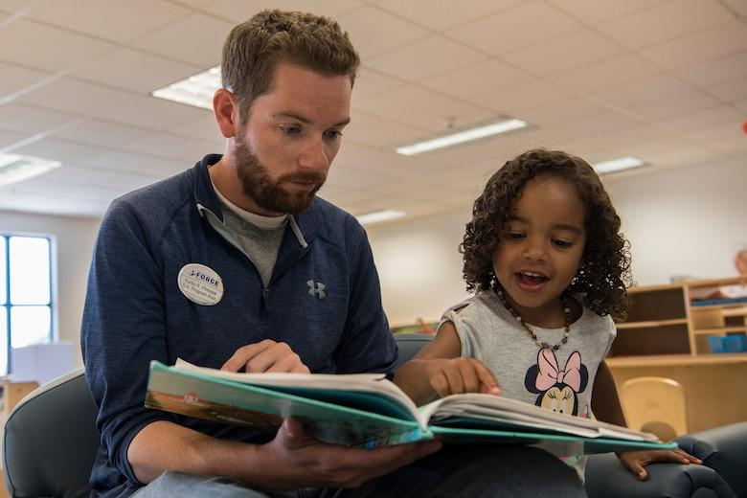
How do teachers impact students?
Tone of voice
Physical proximity
Using the student's name
Shifting tone/attitude based on student
Our own frustration or calmness
https://www.edutopia.org/video/demonstrating-self-regulation-tone-voice

Slide 7
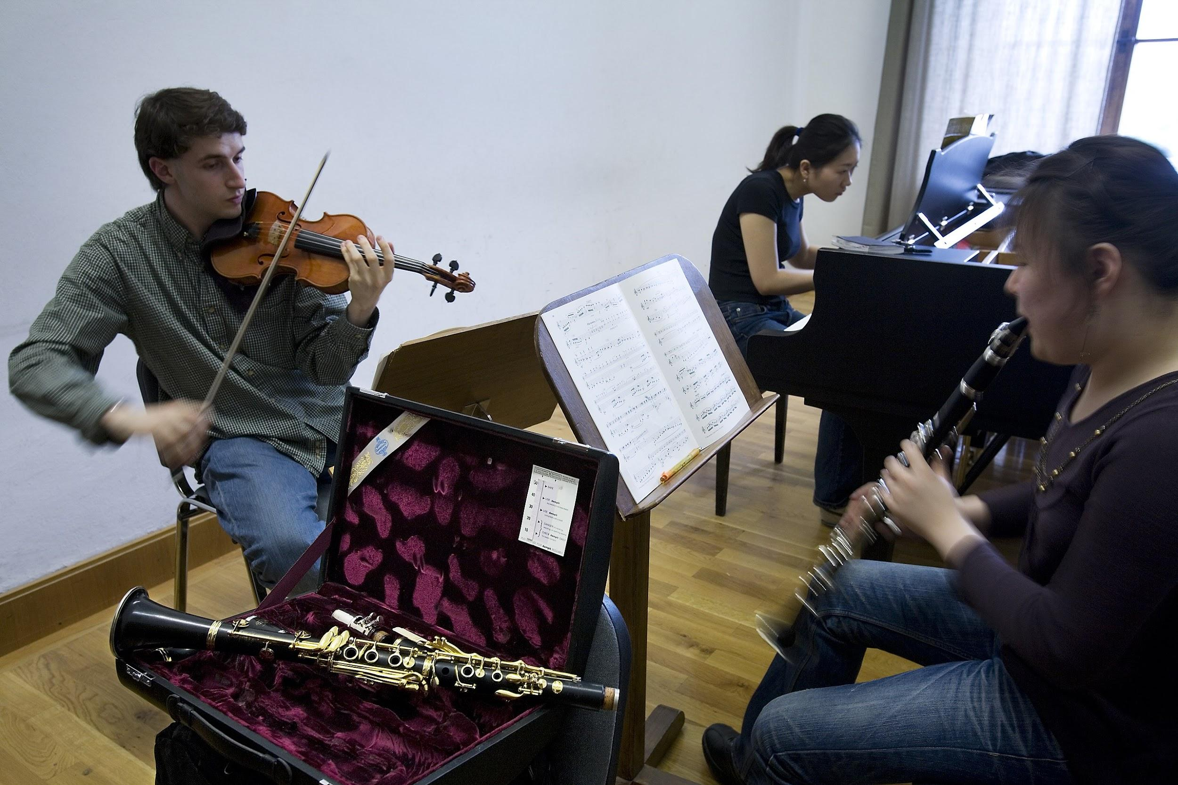
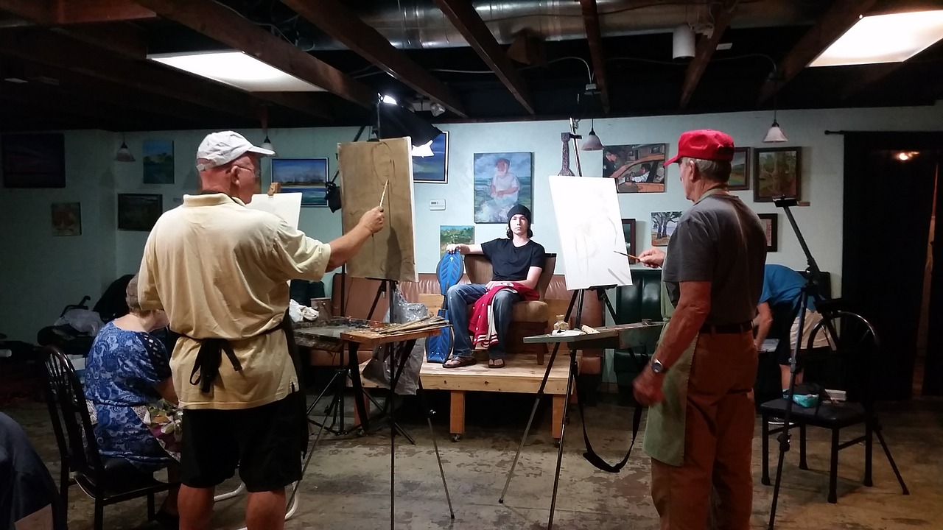
What can you do?
Foster Relationships with difficult students! Rita Pearson said it best, “kids don’t learn from people they don’t like.”
Highlight students uniqueness
Discuss appropriate modifications, behavior plans, needs with a special education teacher, psychologist, social worker and/or counselor
Look for opportunities to highlight students with invisible disabilities
Add in visuals whenever possible
Use peer models
Prepare for transitions throughout the period (make sure the student has all the materials needed)
https://www.ted.com/talks/rita_pierson_every_kid_needs_a_champion

Slide 8
Additional Strategies
Incentives (whole class or Individual)
Modeling behaviors with another adult
Contract with student
Providing Specific Jobs
Positive Behavioral Intervention Supports (PBIS)
https://youtu.be/Q3wpviS5gaQ

Slide 9
References
https://parents-together.org/explaining-invisible-disabilities-to-kids/
https://www.edutopia.org/blog/understanding-invisible-disabilities-robyn-scott
https://www.ascd.org/el/articles/dont-forget-about-me
https://www.edutopia.org/blog/understanding-invisible-disabilities-robyn-scott
https://www.additudemag.com/wp-content/uploads/2017/07/11-Tips-for-redirecting-Focus.pdf
https://www.ldrfa.org/tips-and-strategies-to-help-students-with-adhd-succeed/

